Slide 1


Waste Management: A Collaborative Effort
Waste management is a complex issue requiring the coordinated efforts of public, private, and governmental organizations. This presentation explores the intricate ecosystem of waste management, emphasizing the importance of collaboration and a holistic approach to waste reduction, reuse, and recycling.
by Ashmitha Suma Raj

Slide 2
Understanding the Waste Management Ecosystem
Public Organizations
Private Sector Enterprises
Government Regulation
Cities, municipalities, and local governments play a crucial role in collecting, transporting, and processing waste. They also implement policies and regulations to ensure responsible waste management practices.
Private companies are involved in various aspects of waste management, such as collection, transportation, recycling, and disposal. They also develop innovative technologies and solutions to improve efficiency and sustainability.
Government agencies are responsible for setting standards, enforcing regulations, and promoting sustainable waste management practices. This includes establishing policies for waste disposal, recycling, and environmental protection.

Slide 3

The Role of Public Organizations
Waste Collection
Waste Processing
Public organizations are responsible for collecting waste from residential and commercial areas, ensuring regular and efficient service to communities.
Public organizations may operate or oversee waste processing facilities such as landfills, incinerators, and recycling centers.
Public Education
Environmental Monitoring
Public organizations are responsible for educating citizens about waste management practices, recycling programs, and responsible disposal methods.
Public organizations monitor and evaluate the environmental impact of waste management practices, ensuring compliance with regulations and protecting public health.

Slide 4





The Role of Private Sector Enterprises
Waste Collection & Transportation
Recycling & Reprocessing
Private businesses operate recycling facilities, separating and processing recyclable materials, and transforming them into new products.
Private companies provide specialized collection and transportation services, utilizing modern technologies and efficient logistics for waste management.
Waste-to-Energy & Innovation
Waste Management Investments
Private companies develop and implement innovative technologies, such as waste-to-energy solutions and advanced recycling methods.
Private investors play a crucial role in funding research, development, and deployment of sustainable waste management technologies.

Slide 5

The Importance of Government Regulation and Policies
1
Waste Disposal Standards
2
Recycling Mandates
Government regulations establish strict standards for waste disposal, including landfill operations, incineration, and other methods.
Government policies mandate specific recycling rates for different materials, promoting responsible resource management and waste reduction.
3
Incentive Programs
4
Environmental Protection
Government incentives, such as tax breaks or subsidies, encourage private sector investment in sustainable waste management technologies.
Government regulations ensure compliance with environmental protection laws, protecting public health and the environment from the harmful impacts of waste.

Slide 6





Introducing the 5R's of Waste Management
Refuse
1
The most important step in reducing waste is to refuse unnecessary products and items.
2
Reduce
Minimize the amount of waste generated by consuming less and choosing products with minimal packaging.
3
Reuse
Extend the lifespan of products by repairing, repurposing, or finding creative ways to use them again.
Recycle
4
Process and transform used materials into new products, reducing the demand for virgin resources.
5
Recover
Extract value from waste through energy recovery, composting, or other methods.

Slide 7
Reduce: Minimizing Waste Generation
Reduce Consumption
1
Buy less, consume less, and prioritize durable and sustainable products.
Choose Sustainable Products
2
Opt for products with minimal packaging, reusable components, and long lifespans.
Compost Food Waste
3
Turn food scraps into nutrient-rich compost, reducing landfill waste and enriching soil.
Avoid Single-Use Items
4
Utilize reusable water bottles, coffee cups, and other items to minimize disposable waste.

Slide 8

Reuse: Extending the Lifecycle of Products
1
2
Repair
Repurpose
Fix broken items instead of discarding them, extending their useful life.
Find new uses for old items, transforming them into something different and functional.
3
4
Donate
Share
Give gently used items to charities or organizations, providing new life for things you no longer need.
Borrow or lend items among friends and neighbors, reducing the need for individual purchases.

Slide 9
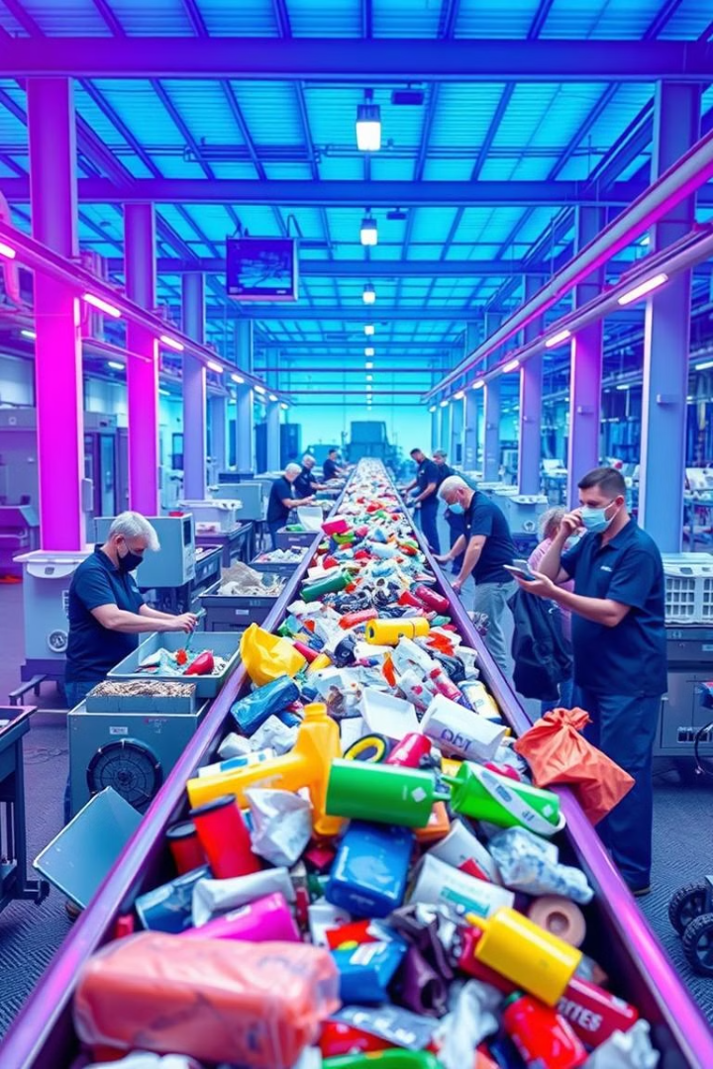




Recycle: Recovering and Repurposing Materials
Proper Sorting
Separate recyclable materials according to their type, ensuring proper processing and efficient resource recovery.
Recycling Programs
Participate in local recycling programs, following guidelines for proper disposal and material separation.
Support Recycling Businesses
Choose products made from recycled materials and support companies committed to sustainable practices.
Reduce Contamination
Minimize contamination in recycling bins, ensuring that recyclable materials are clean and free of non-recyclable items.

Slide 10



Recover: Extracting Value from Waste

Slide 11


